Slide 1
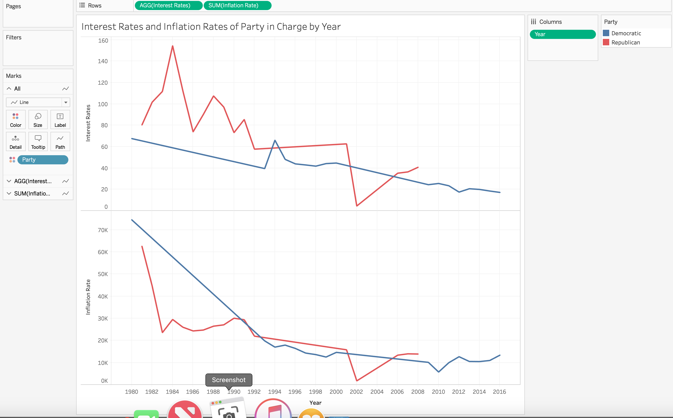
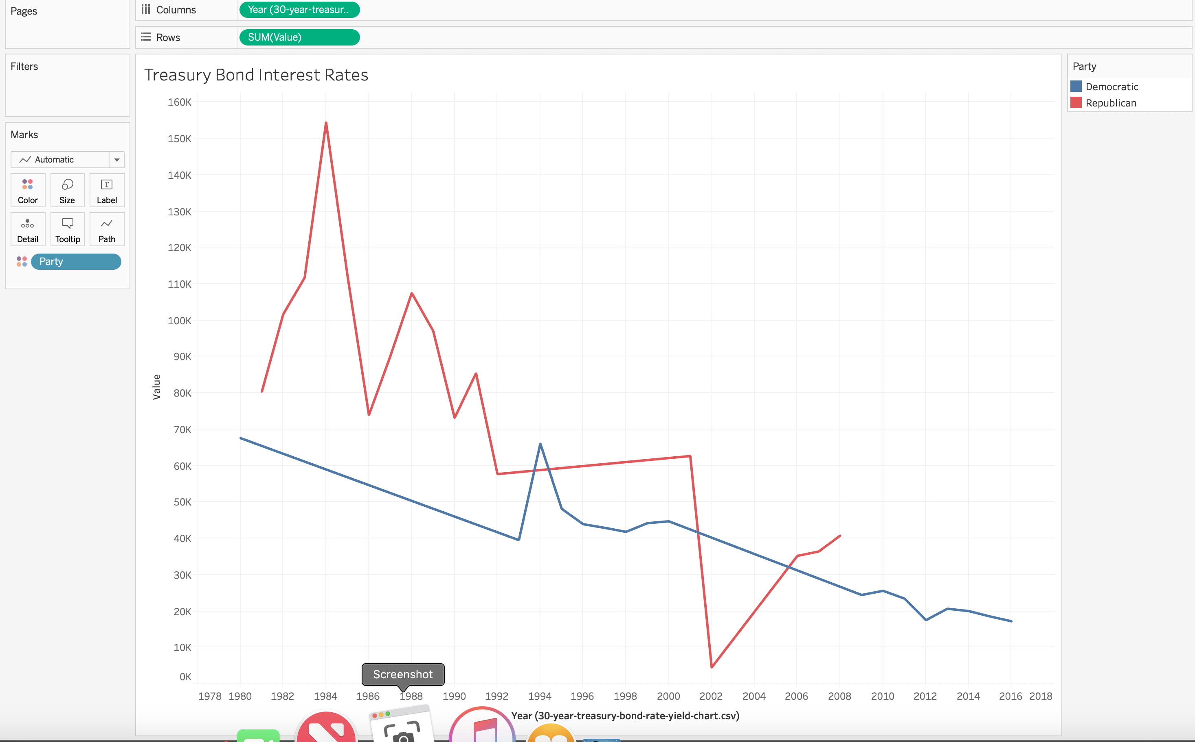
Notes:
Interest rates appear to be higher when the republican party is in power. The democratic party overall maintains a lower interest rate when they are in power.
The inflation was high in the 80’s,but appears to level out to a lower trend in the 2000’s.
The treasury bond rate and the mortgage rate are the same across the board, so you can see that the rates appear to trend downward after 1894; however it appears that overall the democratic party maintains a lower treasury bond rate overe

